Slide 1


Marco Travaglini
April 8, 2022

Slide 2

Outline
Executive Summary
Introduction
Methodology
Results
Conclusion
Appendix

Slide 3
Executive Summary
Summary of methodologies
Summary of all results

Slide 4
Introduction
Space travel has advanced tremendously over the last several years. Companies like Virgin Galactic, Blue Origin and SpaceX are making space travel affordable in the areas of sub-orbital space flights, launching small satellites, establishing a low-orbit internet satellite grids and providing transportation to and from the International Space Station.
This project focuses on SpaceX and their reusable Falcon 9 first-stage rocket landing success rate. The success of SpaceX hinges on their relatively inexpensive rocket launches. The cost of the launches is hugely impacted by whether the landing of the reusable rocket is successful or not.
We will analyze the various rocket launch data attributes to predict whether the Falcon 9 first stage landing will be successful or not.

Slide 5

Section 1

Slide 6
Methodology
Executive Summary
Data collection methodology:
Describe how data was collected
Perform data wrangling
Describe how data was processed
Perform exploratory data analysis (EDA) using visualization and SQL
Perform interactive visual analytics using Folium and Plotly Dash
Perform predictive analysis using classification models
How to build, tune, evaluate classification models

Slide 7
Data Collection
Describe how data sets were collected.
You need to present your data collection process use key phrases and flowcharts

Slide 8
Data Collection

Slide 9
Data Collection – SpaceX API
The first method used for data collection is the SpaceX Open Source REST API described by
https://github.com/r-spacex/SpaceX-API
The main launch data for all past SpaceX launches is retrieved from the REST API endpoint
https://api.spacexdata.com/v4/launches/past
(To make the requested JSON results more consistent, we will use the following static response object for this project:
https://cf-courses-data.s3.us.cloud-object-storage.appdomain.cloud/IBM-DS0321EN-SkillsNetwork/datasets/API_call_spacex_api.json)
We use the Python requests library to access the https API endpoints. This returns the data in JSON format, which we store as a variable using Python json() method and then convert it to a Pandas dataframe using the Pandas json_normalize() method.
Most of the required data is now stored in the dataframe, however, many of the attributes are just IDs. For example, the rocket column has no information about the rocket but just an identification number.
We use the API again to get information about the launches using the IDs given for each launch. Specifically, we use columns rocket, payloads, launchpad, and cores which are all IDs to retrieve more information from the following API’s:
https://api.spacexdata.com/v4/rockets/
https://api.spacexdata.com/v4/payloads/
https://api.spacexdata.com/v4/launchpads/
https://api.spacexdata.com/v4/cores/

Slide 10
Data Collection – SpaceX API
SpaceX API Call Flowchart

Slide 11
Data Collection – SpaceX API
GIT URL
https://github.com/mtravaglini/DataScienceCapstone/blob/master/jupyter-labs-spacex-data-collection-api.ipynb

Slide 12
Data Collection - Scraping
Present your web scraping process using key phrases and flowcharts
Add the GitHub URL of the completed web scraping notebook, as an external reference and peer-review purpose
Place your flowchart of web scraping here

Slide 13
Data Collection - Scraping
We also use web scraping to collect additional SpaceX launch data. The Python requests library is used to access the following website:
https://en.wikipedia.org/w/index.php?title=List_of_Falcon_9_and_Falcon_Heavy_launches&oldid=1027686922
(we use a Wikipedia snapshot page to ensure consistent results for this project)
The BeautifulSoup library is used to store the resulting data as an html object. The data that we are interested in on the webpage is store in html tables. We use the find_all("table") method on the html object to access all the tables. From there, we access the specific table we want and then access all the <th> (i.e., table header) elements from the table to use as the column names:
['Flight No.', 'Date and time ( )', 'Launch site', 'Payload', 'Payload mass', 'Orbit', 'Customer', 'Launch outcome’]
From here, we access all the <tr> (i.e., table row) elements from the table, and store the data in a Python list for each column. These lists are themselves all stored in a Python dictionary object. Once all the data is scraped, the dictionary is converted to a Pandas dataframe.

Slide 14
Data Collection - Scraping
SpaceX Web Scraping Flowchart

Slide 15
Data Collection – Scraping
GIT URL
https://github.com/mtravaglini/DataScienceCapstone/blob/master/jupyter-labs-webscraping.ipynb

Slide 16
Data Wrangling
Describe how data were processed
You need to present your data wrangling process using key phrases and flowcharts
Add the GitHub URL of your completed data wrangling related notebooks, as an external reference and peer-review purpose

Slide 17
Data Wrangling
There were several different aspects to the data wrangling component of this project. Some of the wrangling is necessarily mixed in with the Data Collection steps. For example, when acquiring data via the SpaceX API, the data needed to be transformed into the structure and formats suitable for the analysis we want to perform.
The updates made were:
discard unneeded columns that were returned by the API, so keep only the required columns as follows
data = data[['rocket', 'payloads', 'launchpad', 'cores', 'flight_number', 'date_utc’]]
remove rows with multiple cores because those are falcon rockets with 2 extra rocket boosters
remove rows that have multiple payloads in a single rocket
data = data[data['cores'].map(len)==1]
data = data[data['payloads'].map(len)==1]
change ‘payloads’ and ‘cores’ columns from single-value lists to text values
data['cores'] = data['cores'].map(lambda x : x[0])
data['payloads'] = data['payloads'].map(lambda x : x[0])
convert ‘date_utc’ to a datetime datatype, keeping only the date portion and discarding the time
keep only the rows with a date <= November 13, 2020
data['date'] = pd.to_datetime(data['date_utc']).dt.date
data = data[data['date'] <= datetime.date(2020, 11, 13)]
keep only Falcon 9 launches
data_falcon9 = data[data['BoosterVersion']=='Falcon 9']

Slide 18
Data Wrangling - cont’d
Next the data was checked for any missing/null values. We used the following command to check:
data_falcon9.isnull().sum()
FlightNumber 0
PayloadMass 5
LandingPad 26
Orbit 0
… etc.
This showed that the ‘PayloadMass’ and ‘LandingPad’ columns had several missing values. For ‘LandingPad’, we can leave this as is, since the value None just means there was no landing pad used for that launch. For ‘PayloadMass’, we decide to replace the missing values with the mean of that column. This is done as follows:
PayloadMassMean = data_falcon9['PayloadMass'].mean()
data_falcon9['PayloadMass'] = data_falcon9['PayloadMass'].replace(np.nan, PayloadMassMean)

Slide 19
Data Wrangling - cont’d
Part of Data Wrangling involves data discovery to gain an understanding of what the data means. For example, the ‘Outcome’ column has values such as:
True Ocean means the mission outcome was successfully landed to a specific region of the ocean
False Ocean means the mission outcome was unsuccessfully landed to a specific region of the ocean
True RTLS means the mission outcome was successfully landed to a ground pad
etc.
We want to change this to values of ‘0’ for failed landings and ‘1’ for successful landings. First, we determine all the failed landing values of the ‘Outcome’ column and save them in a set:
for i,outcome in enumerate(landing_outcomes.keys()):
print(i,outcome)
0 True ASDS
1 None None
2 True RTLS
3 False ASDS
4 True Ocean
5 None ASDS
6 False Ocean
7 False RTLS
bad_outcomes=set(landing_outcomes.keys()[[1,3,5,6,7]])

Slide 20
Data Wrangling - cont’d
Once we’ve done that, we can use the set to add a ‘Class’ column to the dataframe:
landing_class = list(df['Outcome'].isin(bad_outcomes).replace({True: 0, False: 1}))
df['Class']=landing_class
df[['Class','Outcome']].head(8)
Class Outcome
0 None None
0 None None
0 None None
0 False Ocean
0 None None
0 None None
1 True Ocean
1 True Ocean
Now we have a Boolean column indicating successful/failed landings.

Slide 21
Data Wrangling
GIT URL
https://github.com/mtravaglini/DataScienceCapstone/blob/master/jupyter-labs-spacex-data-collection-api.ipynb
https://github.com/mtravaglini/DataScienceCapstone/blob/master/labs-jupyter-spacex-Data%20wrangling.ipynb

Slide 22
EDA with Data Visualization
Summarize what charts were plotted and why you used those charts
Add the GitHub URL of your completed EDA with data visualization notebook, as an external reference and peer-review purpose

Slide 23
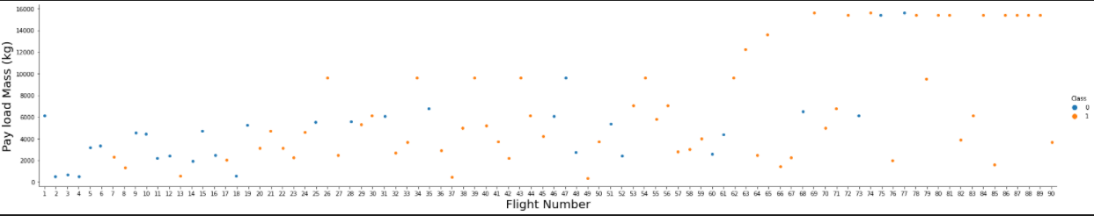
EDA with Data Visualization
The first chart plotted was FlightNumber vs. PayloadMass. We can see how the flight number (indicating the continuous launch attempts) and the payload mass affect the outcome (i.e., Class column) of the launch. Note that Class 1 is success and Class 0 is a failure.
We see that the launch is more likely to land successfully on later launches. The payload mass also affects the outcome, the more massive the payload the less likely that the launch is successful.

Slide 24
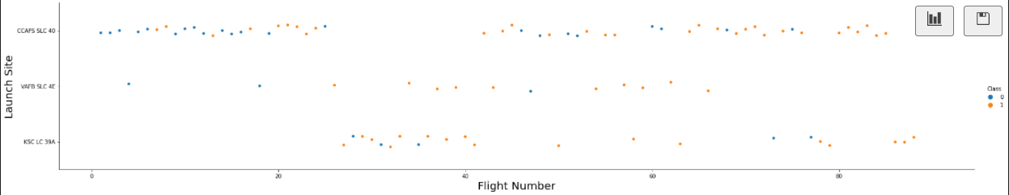
EDA with Data Visualization – cont’d
The next chart plotted is FlightNumber vs. LaunchSite to see if the launch site had any effect on the success rate. We can easily get the success percent by launch site as follows:
df.groupby(by=['LaunchSite'])['Class'].mean() * 100
LaunchSite
CCAFS SLC 40 60.000000
KSC LC 39A 77.272727
VAFB SLC 4E 76.923077
Most of the launches are at CCAFS SLC 40, even though it has the lowest success percentage. Later launches (i.e., increasing flight numbers) are more frequently successful than earlier launches.

Slide 25
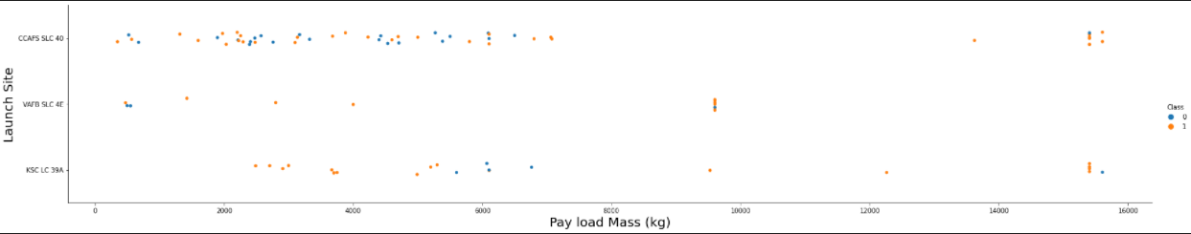
EDA with Data Visualization – cont’d
The next chart plotted is PayloadMass vs. LaunchSite to see if there is any relationship between the two.
This shows that the VAFB-SLC launches have lighter payloads, all less than 10,000. For KSC LC 39A, most failures are around the 6,000kg mark and most of them have failed. For CCAFS SLC 40, the successes and failures are fairly evenly spread except for the very heavy payloads, around 14-16,000kg, where most of them are successful.

Slide 26
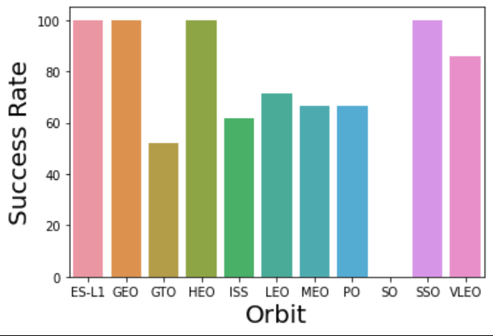
EDA with Data Visualization – cont’d
Next is a bar chart showing the percentage of successful launches by Orbit. We can calculate this with:
df.groupby(by=['Orbit'])['Class'].mean() * 100
Orbit
ES-L1 100.000000
GEO 100.000000
GTO 51.851852
HEO 100.000000
ISS 61.904762
LEO 71.428571
MEO 66.666667
PO 66.666667
SO 0.000000
SSO 100.000000
VLEO 85.714286
This shows that the ES-L1, GEO, HEO and SSO are 100% successful. The VLEO orbit is also good at 86%, and the rest are all in the 50-60% success range. the SO orbit is 0% successful, but if we look further at the data, this is only for 1 launch attempt so may not be indicative.

Slide 27
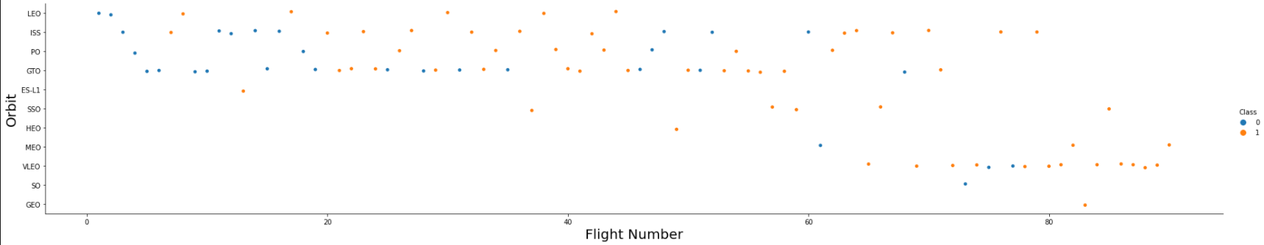
EDA with Data Visualization – cont’d
Next is a scatter plot showing the relationship between FlightNumber and Orbit type.
For LEO and VLEO orbit the successes increase significantly with later flights. The 100% successful ones (ES-L1, GEO, HEO and SSO) all have relatively fewer launches. The SO orbit has just a single launch. The remaining orbits seem to fluctuate between failure and successes.

Slide 28
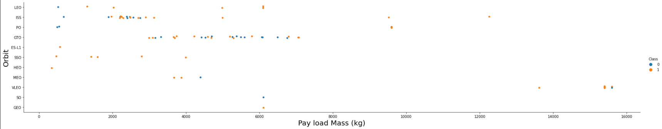
EDA with Data Visualization – cont’d
Next is a scatter plot showing the relationship between PayloadMass and Orbit type.
With heavy payloads over 9,000kg, they are successful with the exception of one VLEO orbit launch.
The lighter payloads are mainly successful with the exception of ISS, PO and GTO which have several failures mixed in with the successes.

Slide 29
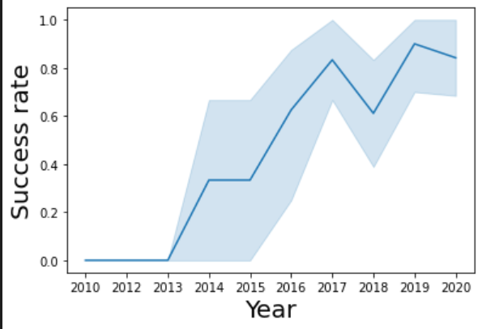
EDA with Data Visualization – cont’d
Next, we look at the yearly trend of the launch success rate trend.
We can see the success rate increase steadily from 2013, but with smaller drops in 2018 and 2020.

Slide 30
EDA with Data Visualization – cont’d
GIT URL
https://github.com/mtravaglini/DataScienceCapstone/blob/master/jupyter-labs-eda-dataviz.ipynb

Slide 31
EDA with SQL
Following is a summary of the Exploratory Data Analysis SQL that was used.
1) List the unique launch sites names.
SELECT distinct(launch_site)
FROM SPACEXTBL;
2) List 5 rows with launch site names that begin with CCA.
SELECT *
FROM SPACEXTBL
WHERE launch_site like 'CCA%'
LIMIT 5;
3) Return the total payload mass carried by boosters launched by NASA (CRS).
SELECT SUM(payload_mass__kg_) AS payload_mass_total
FROM SPACEXTBL
WHERE customer = 'NASA (CRS)’;
4) Return the average payload mass carried by booster version F9 v1.1.
SELECT AVG(payload_mass__kg_) AS payload_mass_avg
FROM SPACEXTBL
WHERE booster_version = 'F9 v1.1’;

Slide 32
EDA with SQL – cont’d
5) Return the date when the first successful landing outcome in ground pad was achieved.
SELECT MIN(date) AS first_date
FROM SPACEXTBL
WHERE landing__outcome = 'Success (ground pad)’;
6) List the names of the boosters which have success in drone ship landings and have payload mass greater than 4000 but less than 6000 kg.
SELECT booster_version
FROM SPACEXTBL
WHERE landing__outcome = 'Success (drone ship)'
AND payload_mass__kg_ > 4000
AND payload_mass__kg_ < 6000;
7) List the total number of successful and failure mission outcomes.
SELECT 'Success' AS outcome, COUNT(*) AS total
FROM SPACEXTBL
WHERE landing__outcome like 'Success%' or landing__outcome like 'Controlled%’
UNION
SELECT 'Failures' AS outcome, COUNT(*) AS total
FROM SPACEXTBL
WHERE landing__outcome not like 'Success%' AND landing__outcome not like 'Controlled%';

Slide 33
EDA with SQL – cont’d
8) List the names of the booster versions which have carried the maximum payload mass.
SELECT distinct booster_version, payload_mass__kg_
FROM SPACEXTBL
WHERE payload_mass__kg_ =
(SELECT MAX(payload_mass__kg_)
FROM SPACEXTBL);
9) List the failed landing outcomes in drone ship, their booster versions, and launch site names for the year 2015.
SELECT distinct landing__outcome, booster_version, launch_site
FROM SPACEXTBL
WHERE year(date) > 2015
AND landing__outcome = 'Failure (drone ship)’;
10) List the count of all landing outcomes between the date 2010-06-04 and 2017-03-20, in descending order.
SELECT landing__outcome, COUNT(*) AS outcome_count
FROM SPACEXTBL
WHERE DATE BETWEEN '2010-06-04' AND '2017-03-20'
GROUP BY landing__outcome
ORDER BY outcome_count desc;

Slide 34
EDA with SQL – cont’d
GIT URL
https://github.com/mtravaglini/DataScienceCapstone/blob/master/jupyter-labs-eda-sql-coursera.ipynb

Slide 35
Build an Interactive Map with Folium
Summarize what map objects such as markers, circles, lines, etc. you created and added to a folium map
Explain why you added those objects
Add the GitHub URL of your completed interactive map with Folium map, as an external reference and peer-review purpose

Slide 36
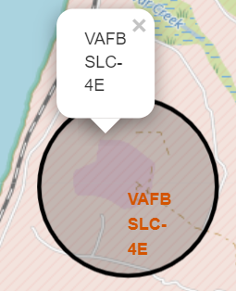
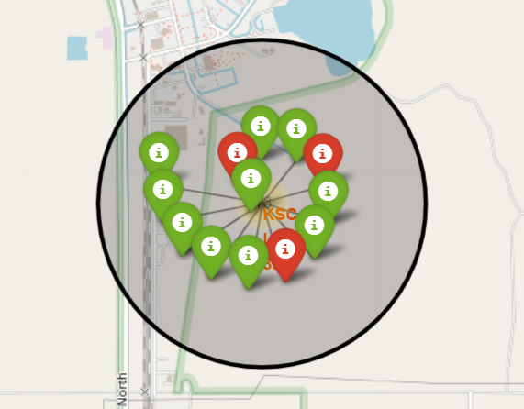
Build an Interactive Map with Folium
Mapping with Folium allows us to do more interactive visual analysis of the launch data. To do this, we need to update the map with launch information.
We also add marker clusters to group markers at each launch site. The markers show successful (green) or failed (red) launches.
We use markers to mark the names of all the launch sites on the map itself. We also add circles around each launch site, so they are easy to see on the map. The circles have a pop-up that also show the name of the launch site when the they are clicked.

Slide 37
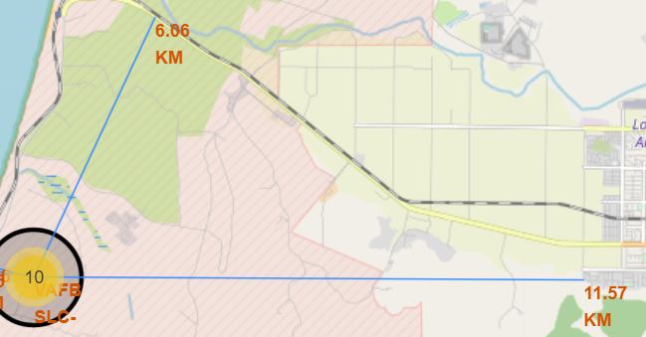
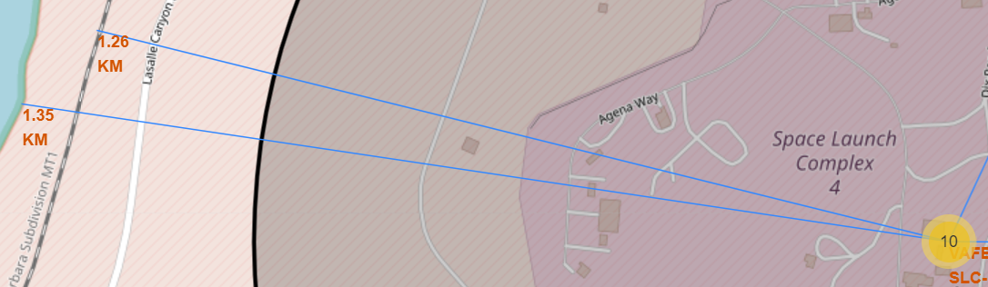
Build an Interactive Map with Folium – cont’d
We’ve also added lines to the map to show distances from significant landmarks that could also influence the location of the launch sites.
Example of lines from the launch site to the nearest railway and coast.
Example of lines from the launch site to the nearest highway and city.
We add the various markers, circles and lines to help find some geographical patterns about launch sites and success rates. The launch sites seem to be nearer to the coastlines (likely for safety in case of failed rocket launches that can land in the ocean rather than on land) and near railways (likely for transportation requirements). They are further away from highways and cities. This is likely for safety and perhaps to reduce noise pollution, by keeping rocket launches away from populated areas.

Slide 38
Build a Dashboard with Plotly Dash
Summarize what plots/graphs and interactions you have added to a dashboard
Explain why you added those plots and interactions
Add the GitHub URL of your completed Plotly Dash lab, as an external reference and peer-review purpose

Slide 39
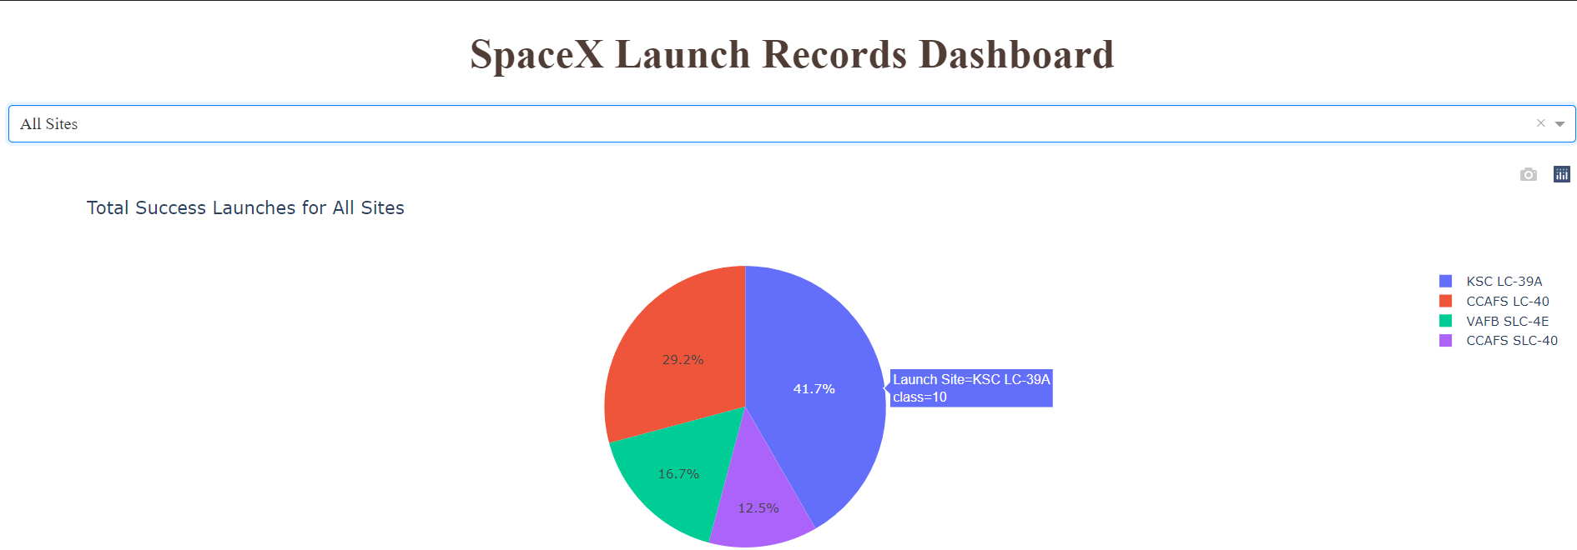
Build a Dashboard with Plotly Dash
Using Plotly, we’ve built a dashboard with two graphs. The first is a pie chart with a drop-down list to select the launch site. If All Sites is selected, the chart shows all the launch sites with each slice indicating the percentage of successful launches from that site. For example, the following shows that 41.7% of successful launches (10 launches) are from the KSC-LC-39A site.

Slide 40
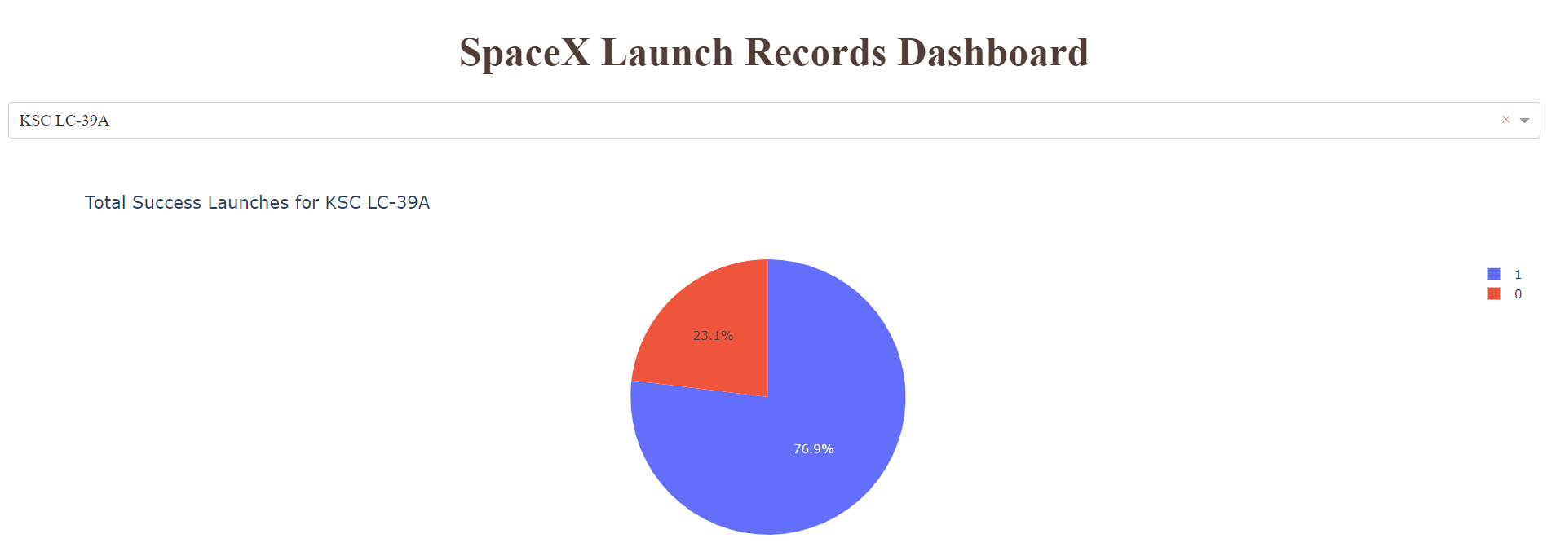
Build a Dashboard with Plotly Dash – cont’d
If a specific site is selected from the drop-down list, the chart shows the percentage of successful and failed launches for that site. For example, the following shows that 76.9% of launches were successful and 23.1% failed from the KSC-LC-39A site.

Slide 41
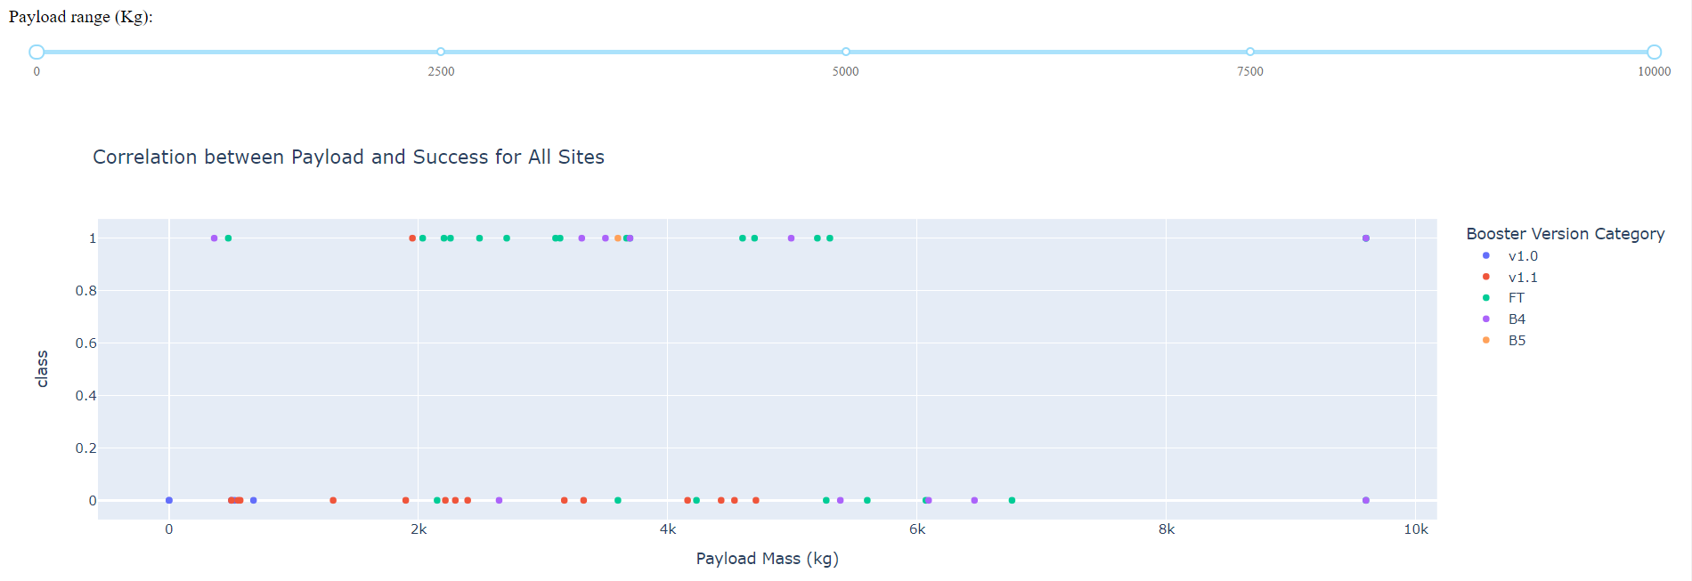
Build a Dashboard with Plotly Dash – cont’d
The second graph in the dashboard is a scatter plot showing the relationship between payload mass and successful launches broken down by booster version category. The same drop-down list can be used to show all the launch sites or to select a specific site. There is also a range slider to limit the display to those payloads that fall within the selected range on the slider. For example, this graph includes all launch sites and all payloads.

Slide 42
Build a Dashboard with Plotly Dash – cont’d
This graph includes all launch sites and payloads.

Slide 43
Predictive Analysis (Classification)
Summarize how you built, evaluated, improved, and found the best performing classification model
You need present your model development process using key phrases and flowchart
Add the GitHub URL of your completed predictive analysis lab, as an external reference and peer-review purpose

Slide 44
Predictive Analysis (Classification)

Slide 45
Results
Exploratory data analysis results
Interactive analytics demo in screenshots
Predictive analysis results

Slide 46

Section 2

Slide 47
Flight Number vs. Launch Site
Show a scatter plot of Flight Number vs. Launch Site
Show the screenshot of the scatter plot with explanations

Slide 48
Payload vs. Launch Site
Show a scatter plot of Payload vs. Launch Site
Show the screenshot of the scatter plot with explanations

Slide 49
Success Rate vs. Orbit Type
Show a bar chart for the success rate of each orbit type
Show the screenshot of the scatter plot with explanations

Slide 50
Flight Number vs. Orbit Type
Show a scatter point of Flight number vs. Orbit type
Show the screenshot of the scatter plot with explanations

Slide 51
Payload vs. Orbit Type
Show a scatter point of payload vs. orbit type
Show the screenshot of the scatter plot with explanations

Slide 52
Launch Success Yearly Trend
Show a line chart of yearly average success rate
Show the screenshot of the scatter plot with explanations

Slide 53
All Launch Site Names
Find the names of the unique launch sites
Present your query result with a short explanation here

Slide 54
Launch Site Names Begin with 'CCA'
Find 5 records where launch sites begin with `CCA`
Present your query result with a short explanation here

Slide 55
Total Payload Mass
Calculate the total payload carried by boosters from NASA
Present your query result with a short explanation here

Slide 56
Average Payload Mass by F9 v1.1
Calculate the average payload mass carried by booster version F9 v1.1
Present your query result with a short explanation here

Slide 57
First Successful Ground Landing Date
Find the dates of the first successful landing outcome on ground pad
Present your query result with a short explanation here

Slide 58
Successful Drone Ship Landing with Payload between 4000 and 6000
List the names of boosters which have successfully landed on drone ship and had payload mass greater than 4000 but less than 6000
Present your query result with a short explanation here

Slide 59
Total Number of Successful and Failure Mission Outcomes
Calculate the total number of successful and failure mission outcomes
Present your query result with a short explanation here

Slide 60
Boosters Carried Maximum Payload
List the names of the booster which have carried the maximum payload mass
Present your query result with a short explanation here

Slide 61
2015 Launch Records
List the failed landing_outcomes in drone ship, their booster versions, and launch site names for in year 2015
Present your query result with a short explanation here

Slide 62
Rank Landing Outcomes Between 2010-06-04 and 2017-03-20
Rank the count of landing outcomes (such as Failure (drone ship) or Success (ground pad)) between the date 2010-06-04 and 2017-03-20, in descending order
Present your query result with a short explanation here

Slide 63

Section 3

Slide 64
<Folium Map Screenshot 1>
Replace <Folium map screenshot 1> title with an appropriate title
Explore the generated folium map and make a proper screenshot to include all launch sites’ location markers on a global map
Explain the important elements and findings on the screenshot

Slide 65
<Folium Map Screenshot 2>
Replace <Folium map screenshot 2> title with an appropriate title
Explore the folium map and make a proper screenshot to show the color-labeled launch outcomes on the map
Explain the important elements and findings on the screenshot

Slide 66
<Folium Map Screenshot 3>
Replace <Folium map screenshot 3> title with an appropriate title
Explore the generated folium map and show the screenshot of a selected launch site to its proximities such as railway, highway, coastline, with distance calculated and displayed
Explain the important elements and findings on the screenshot

Slide 67

Section 4

Slide 68
<Dashboard Screenshot 1>
Replace <Dashboard screenshot 1> title with an appropriate title
Show the screenshot of launch success count for all sites, in a piechart
Explain the important elements and findings on the screenshot

Slide 69
<Dashboard Screenshot 2>
Replace <Dashboard screenshot 2> title with an appropriate title
Show the screenshot of the piechart for the launch site with highest launch success ratio
Explain the important elements and findings on the screenshot

Slide 70
<Dashboard Screenshot 3>
Replace <Dashboard screenshot 3> title with an appropriate title
Show screenshots of Payload vs. Launch Outcome scatter plot for all sites, with different payload selected in the range slider
Explain the important elements and findings on the screenshot, such as which payload range or booster version have the largest success rate, etc.

Slide 71

Section 5

Slide 72
Classification Accuracy
Visualize the built model accuracy for all built classification models, in a bar chart
Find which model has the highest classification accuracy

Slide 73
Confusion Matrix
Show the confusion matrix of the best performing model with an explanation

Slide 74
Conclusions
Point 1
Point 2
Point 3
Point 4
…

Slide 75
Appendix
Include any relevant assets like Python code snippets, SQL queries, charts, Notebook outputs, or data sets that you may have created during this project

Slide 76
Appendix 1 – Input/Output Datasets
1) jupyter-labs-spacex-data-collection-api.ipynb
in: https://api.spacexdata.com/v4/launches/<xxx>
out: dataset_part_1.csv
2) jupyter-labs-webscraping.ipynb
in: https://en.wikipedia.org/w/index.php?title=List_of_Falcon_9_and_Falcon_Heavy_launches&oldid=1027686922
out: spacex_web_scraped.csv
3) labs-jupyter-spacex-Data wrangling.ipynb
in: https://cf-courses-data.s3.us.cloud-object-storage.appdomain.cloud/IBM-DS0321EN-SkillsNetwork/datasets/dataset_part_1.csv
out: dataset_part_2.csv (add class column)
4) jupyter-labs-eda-dataviz.ipynb
in: # https://cf-courses-data.s3.us.cloud-object-storage.appdomain.cloud/IBM-DS0321EN-SkillsNetwork/datasets/dataset_part_2.csv
in: https://cf-courses-data.s3.us.cloud-object-storage.appdomain.cloud/IBMDeveloperSkillsNetwork-DS0701EN-SkillsNetwork/api/dataset_part_2.csv
out: dataset_part_3.csv (one-hot features)
5) jupyter-labs-eda-sql-coursera.ipynb
in: https://cf-courses-data.s3.us.cloud-object-storage.appdomain.cloud/IBM-DS0321EN-SkillsNetwork/labs/module_2/data/Spacex.csv
out: SPACEXTBL (DB2 database table)

Slide 77
Appendix 1 – Input/Output Datasets cont’d
6) lab_jupyter_launch_site_location.ipynb
in: https://cf-courses-data.s3.us.cloud-object-storage.appdomain.cloud/IBM-DS0321EN-SkillsNetwork/datasets/spacex_launch_geo.csv
out: n/a
7) lab_jupyter_launch_site_location.ipynb
in: https://cf-courses-data.s3.us.cloud-object-storage.appdomain.cloud/IBM-DS0321EN-SkillsNetwork/datasets/spacex_launch_dash.csv
out: n/a
8) spacex_dash_app.py
in: https://cf-courses-data.s3.us.cloud-object-storage.appdomain.cloud/IBM-DS0321EN-SkillsNetwork/datasets/spacex_launch_dash.csv
out: n/a
9) SpaceX_Machine Learning Prediction_Part_5.ipynb
in: https://cf-courses-data.s3.us.cloud-object-storage.appdomain.cloud/IBM-DS0321EN-SkillsNetwork/datasets/dataset_part_2.csv
in: https://cf-courses-data.s3.us.cloud-object-storage.appdomain.cloud/IBMDeveloperSkillsNetwork-DS0701EN-SkillsNetwork/api/dataset_part_2.csv
https://cf-courses-data.s3.us.cloud-object-storage.appdomain.cloud/IBM-DS0321EN-SkillsNetwork/datasets/dataset_part_3.csv
https://cf-courses-data.s3.us.cloud-object-storage.appdomain.cloud/IBMDeveloperSkillsNetwork-DS0701EN-SkillsNetwork/api/dataset_part_3.csv
out: n/a

Slide 78


